Slide 1
JNCIS-ENT
Tunnels

Slide 2
Generic Route Encapsulation
2
Non-IP traffic tunneling

Slide 3
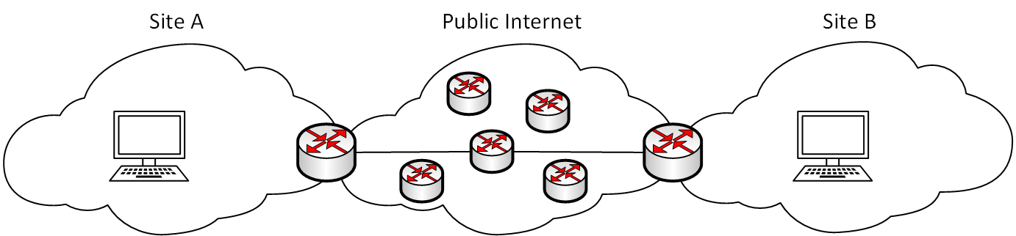
What is a GRE Tunnel?
GRE tunneling encapsulates arbitrary protocols within an IPv4 packet header
GRE can encapsulate IPv6, MPLS, other IPv4 packets or other protocols within an IPv4 packet header
This can allow MPLS or IPv6 network domains to be extended across an IPv4 network that is not part of the domain.
Additional protocols may be encapsulated, like AppleTalk

Slide 4
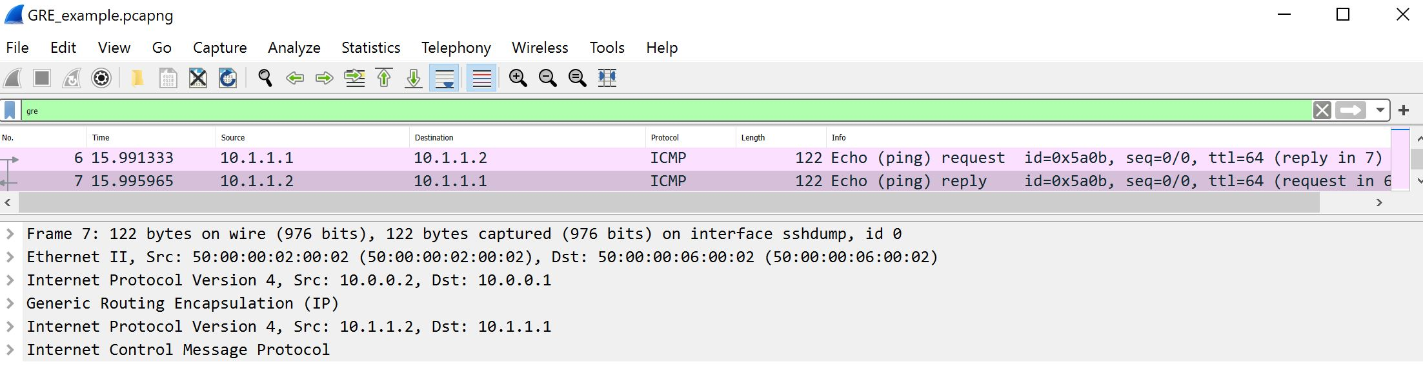
GRE
GRE is defined in RFC 1701, the newer standard defined in RFC 2784 is more commonly used
The header is 8 octets
Extended GRE is defined in RFC 2890 and provides the addition of a key and sequence number field to the GRE header
The extended GRE header is 16 octets

Slide 5
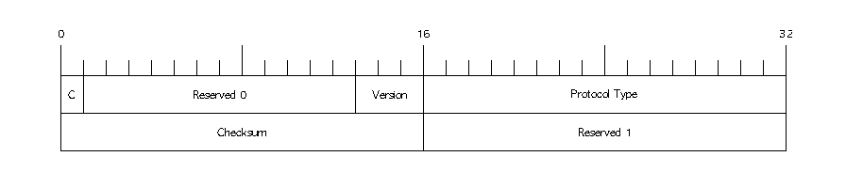
GRE Header Format

Slide 6
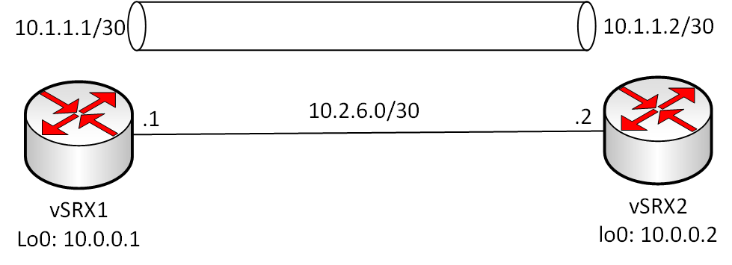
Configuring a GRE Tunnel
lab@vSRX1> show configuration interfaces gr-0/0/0
unit 0 {
tunnel {
source 10.0.0.1;
destination 10.0.0.2;
}
family inet {
address 10.1.1.1/30;
}
}
lab@vSRX2> show configuration interfaces gr-0/0/0
unit 0 {
tunnel {
source 10.0.0.2;
destination 10.0.0.1;
}
family inet {
address 10.1.1.2/30;
}
}

